Slide 1


A Strategic Plan for Davie County
Offering all citizens an opportunity to improve their quality of life while enjoying the benefits of a safe, healthy, prosperous, and vibrant county.

Slide 2


PEOPLE: POPULATION
2010
Population has increased 2.4% over six years
2016
That is 991 people
Population=42,211
Source: US Census Bureau & NC Office of State Budget Management

Slide 3
REGION’S POPULATION GROWTH
Median Age = 44
Higher than our neighbor, Forsyth County and the NC average
Almost one-fifth of residents are age 65 years or older
This is the fastest growing age group, and will represent more than one-fourth of our population by 2037
Source: NC Office of Budget & Management (2016 Certified Population Estimate)

Slide 4
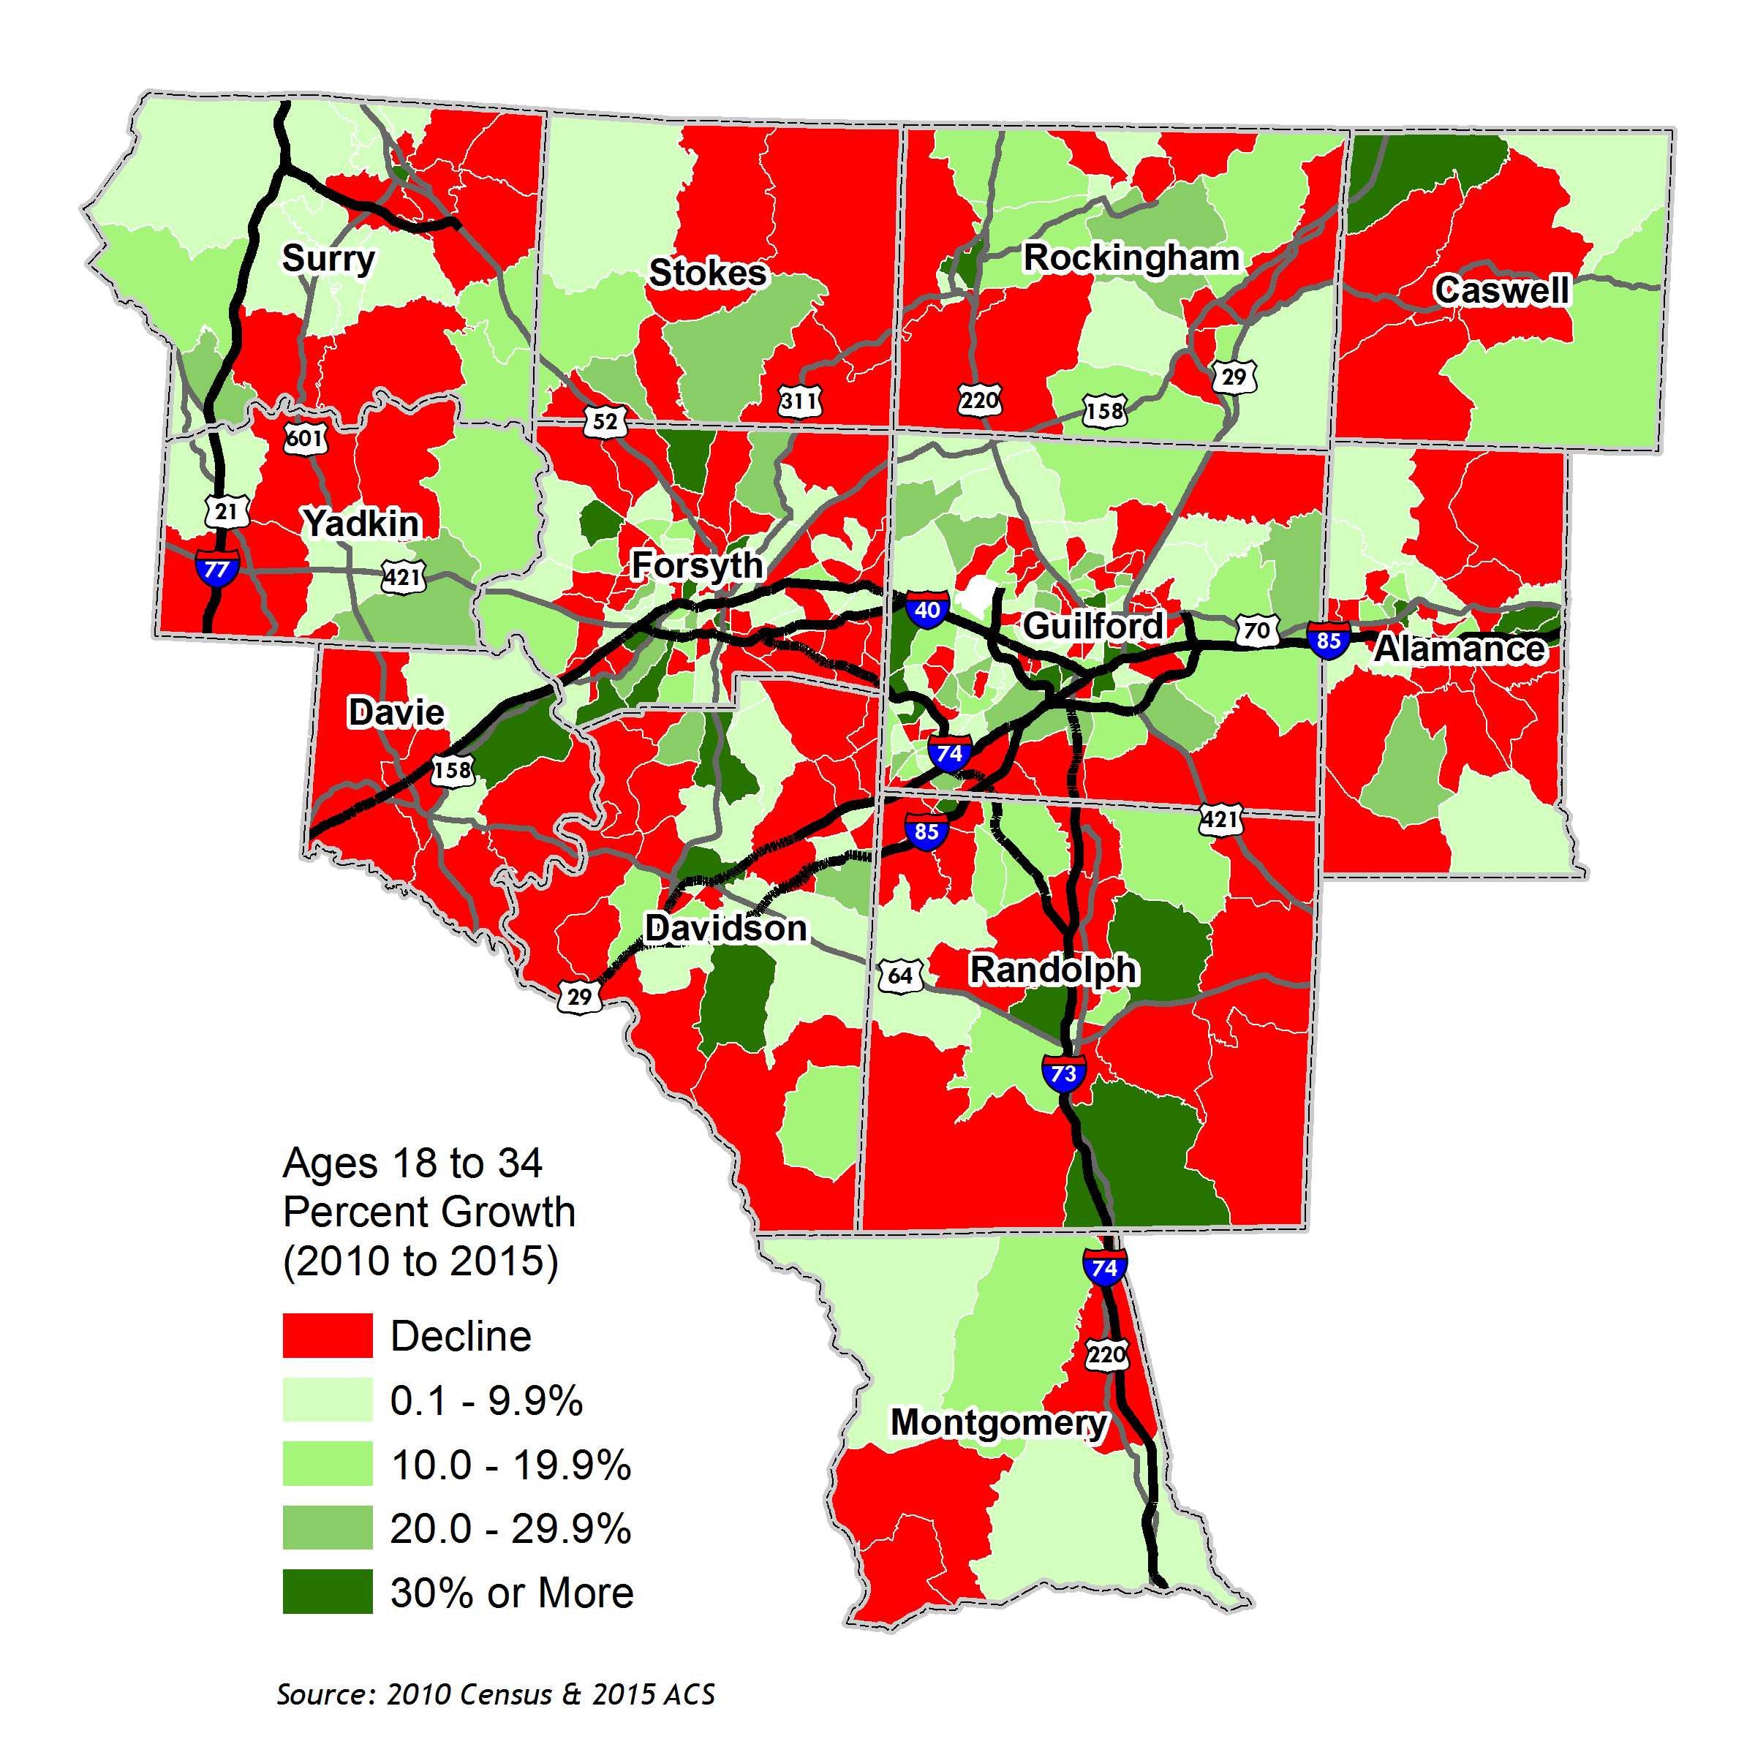
REGION’S POPULATION GROWTH
Population Growth By Census Tract:
Ages 18-34, 2010-2015
, PTRC

Slide 5
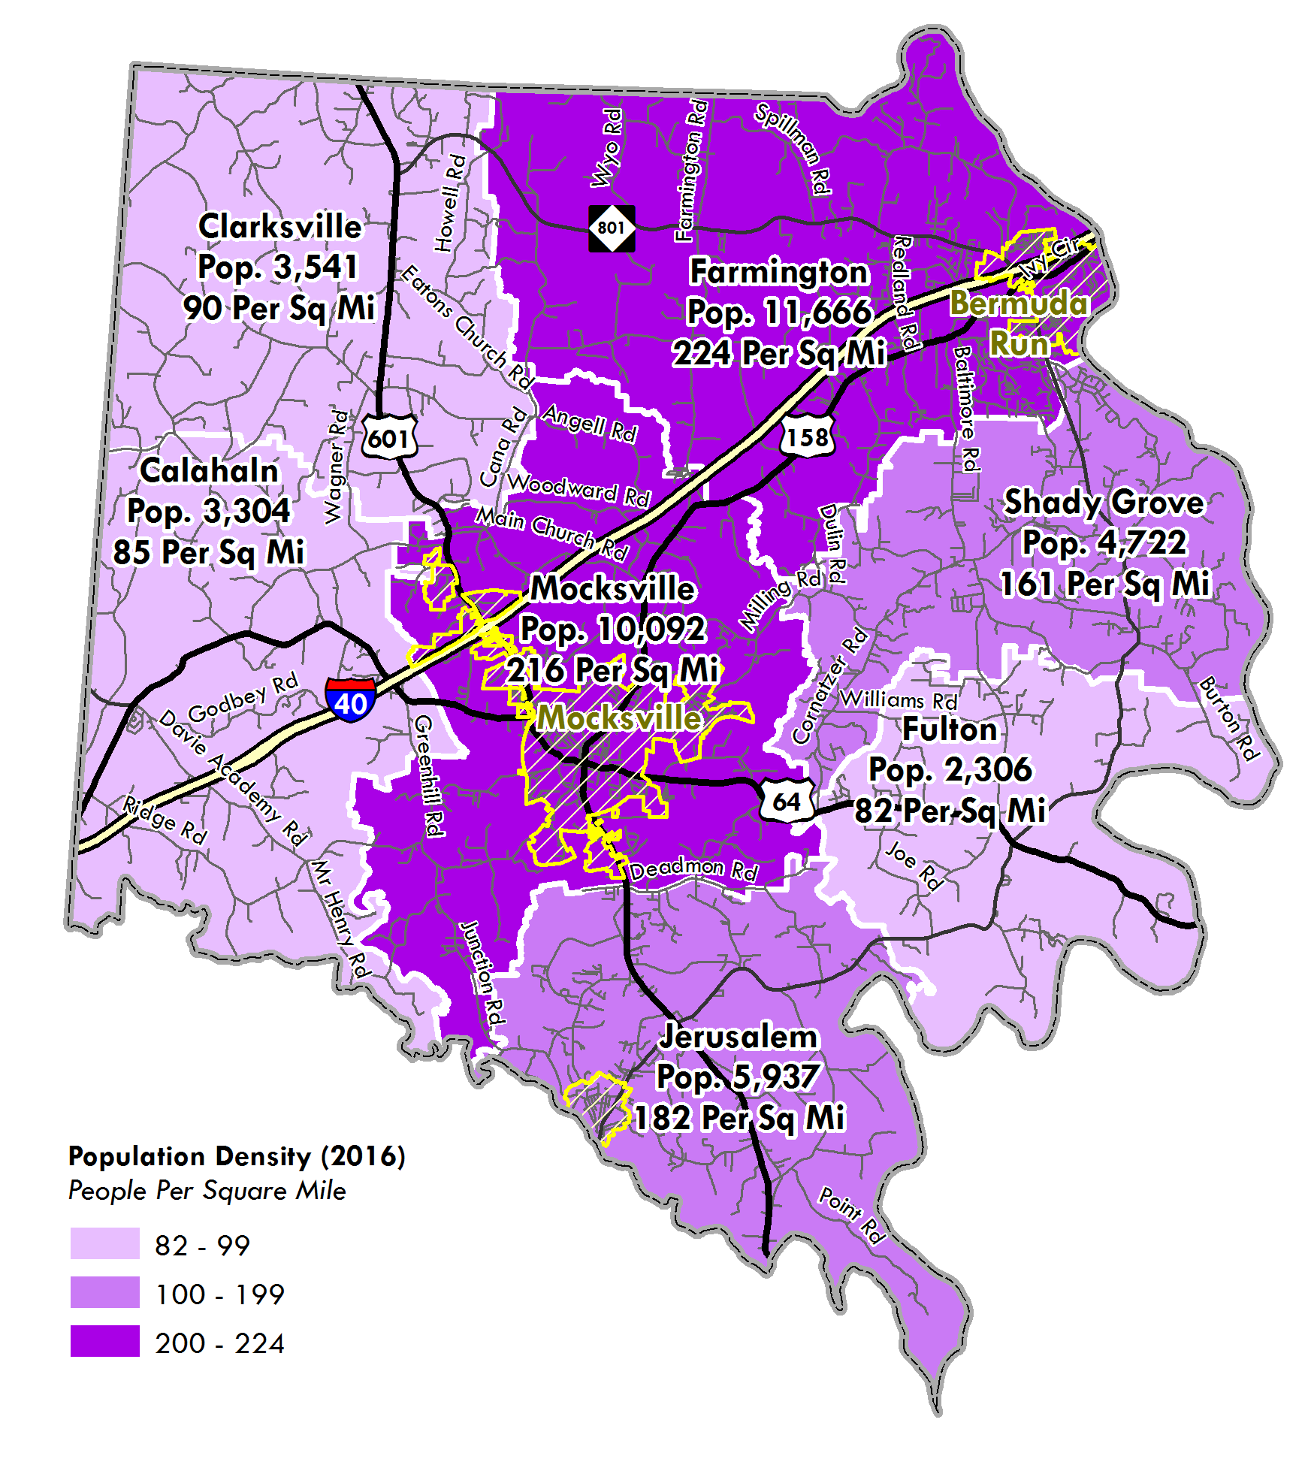
REGION’S POPULATION GROWTH
 | Population Density (Per Square Mile)
Township: | 1970 | 1980 | 1990 | 2000 | 2010 | 2016
Calahaln | 31.0 | 42.1 | 45.8 | 62.4 | 68.5 | 84.7
Clarksville | 41.6 | 54.2 | 63.8 | 82.7 | 95.9 | 90.2
Farmington | 63.7 | 119.6 | 153.2 | 164.4 | 217.0 | 223.7
Fulton | 46.6 | 61.1 | 58.2 | 71.1 | 81.4 | 82.3
Jerusalem | 129.6 | 131.3 | 142.4 | 179.0 | 186.2 | 182.4
Mocksville | 122.1 | 146.1 | 150.2 | 180.6 | 210.6 | 216.1
Shady Grove | 49.9 | 60.7 | 78.3 | 147.5 | 180.9 | 160.9
County Total | 92.3 | 104.5 | 130.7 | 154.7 | 156.0 | 156.0
Source: US Census Bureau American Community Survey 5-Year Estimates (2012-2016)

Slide 6
REGION’S POPULATION GROWTH
The majority of the County’s population lives in unincorporated areas. Mocksville is the largest town with a population of 5,422 in 2016. Bermuda Run has almost doubled in population size since 2000.
 | Population
Municipality: | 1970 | 1980 | 1990 | 2000 | 2010 | 2016
Bermuda Run | - | - | - | 1,431 | 1,725 | 2,610
Cooleemee | - | - | 971 | 905 | 960 | 970
Mocksville | 2,529 | 2,637 | 3,399 | 4,178 | 5,051 | 5,422
Unincorporated Area | 16,326 | 21,962 | 23,489 | 28,321 | 33,504 | 33,209
County Total | 18,855 | 24,599 | 27,859 | 34,835 | 41,240 | 42,211
Population by Municipality (1970-2016)
Source: US Census Bureau Decennial Census; NC Office of Budget & Management (2016 Certified Population Estimate)

Slide 7
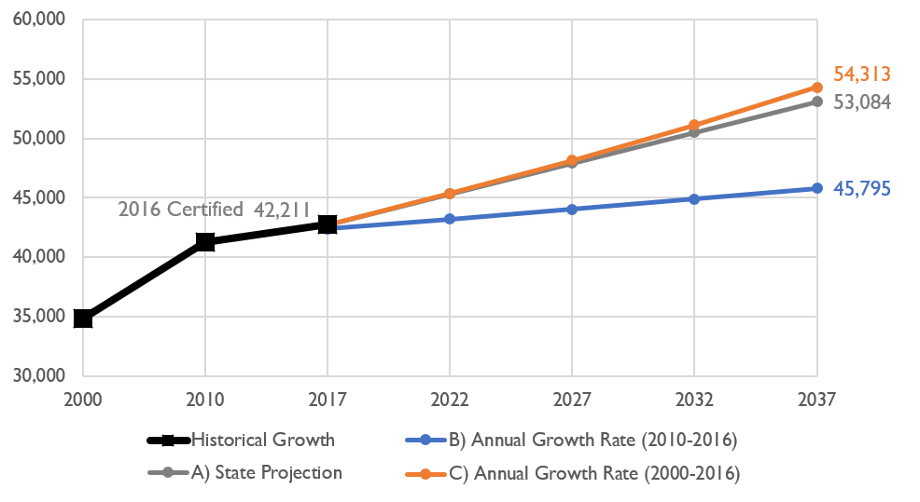
REGION’S POPULATION GROWTH
Projected Population
Multiple scenarios were studied to determine likely growth rates for the County:
Projection A is based on data from the N.C. Office of Budget and Management, which projects that Davie County will reach a population of 53,084 by the year 2037. This is an increase of 10,357 people (24.2%) between 2017 and 2037 with an annual growth rate of 1.09%.
Projection B is based on a continuation of the rate of population growth that the County experienced between 2010 and 2016 – a 0.39% annual growth rate. This is the lowest growth projection, as the County has seen a slower rate of growth in the most recent years.
Projection C is based on a continuation of the rate of population growth that the County experienced between 2000 and 2016 – a 1.21% annual growth rate. This is the highest growth projection, just higher than the state’s projection.

Slide 8

Education
On average, Davie County’s population is more educated than other comparison rural counties:
85.5% of the population has at least a high school education
23.6% have at least a Bachelor’s degree
8.3% of the population have a Master’s degree or higher
Educational attainment needs to continue to be something we focus on
Educational Attainment - Bachelor's Degree or Higher (2016)
Source: US Census Bureau American Community Survey 5-Year Estimates (2012-2016)

Slide 9
INCOME
Davie County’s Median Household Income = $51,662
Higher than NC and all comparison counties; however…
Median Household Incomes (2016)
Source: US Census Bureau American Community Survey 5-Year Estimates (2012-2016)

Slide 10





INCOME
Minimum Wage Is Not The Right Marker
THE SELF-SUFFICIENCY STANDARD VARIES BY FAMILY TYPE
Hourly Self-Sufficient Wage in Davie County
$22.29
$17.06
$16.69 (per adult)
$12.75
(per adult)
$9.45
1 Adult
1 Adult +
1 Preschooler
1 Adult +
1 Preschooler +
1 School-age
2 Adults +
1 Preschooler +
1 School-age
2 Adults +
1 Infant +
1 Preschooler +
1 School-age
http://www.unitedwaync.org/selfsufficiencystandard
http://www.unitedwaync.org/our-money-needs-calculator

Slide 11
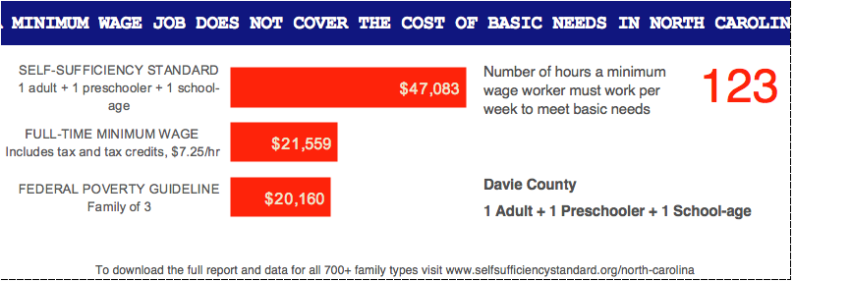
INCOME
MINIMUM WAGE JOB DOES NOT COVER THE COST OF BASIC NEEDS IN NORTH CAROLINA

Slide 12
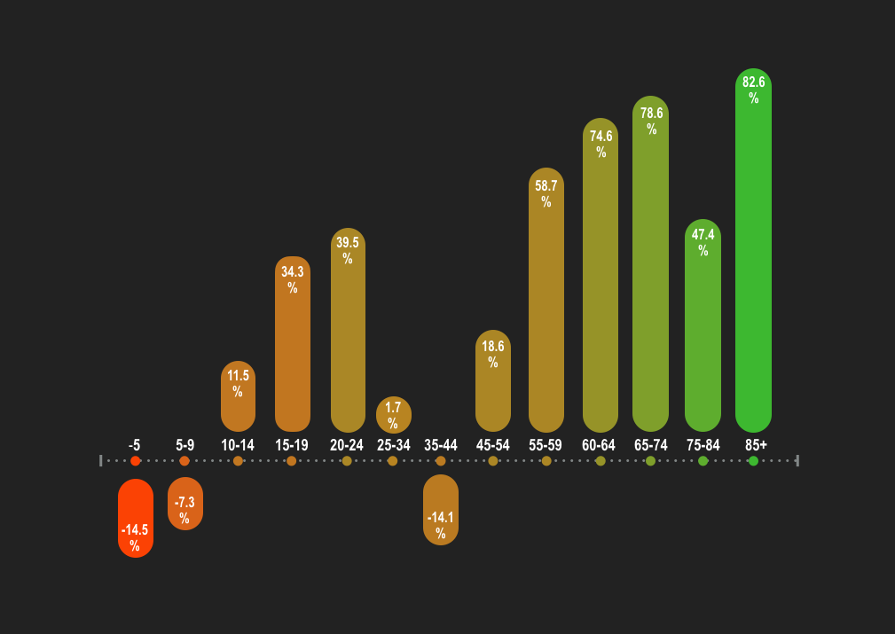
AGE GROUP POPULATION CHANGE
DAVIE COUNTY 2000-2016
Source: 2000 Census, US Census Bureau and NC Office of Budget & Management 2016
Notes:
-5 -14.5%
5-9 -7.3%
10-14 11.5%
15-19 34.3%
20-24 39.5%
25-34 1.7% this one changed from negative to positive
35-44 -14.1%
45-54 18.6%
55-59 58.7%
60-64 74.6%
65-74 78.6%
75-84 47.4%
85+ 82.6%

Slide 13
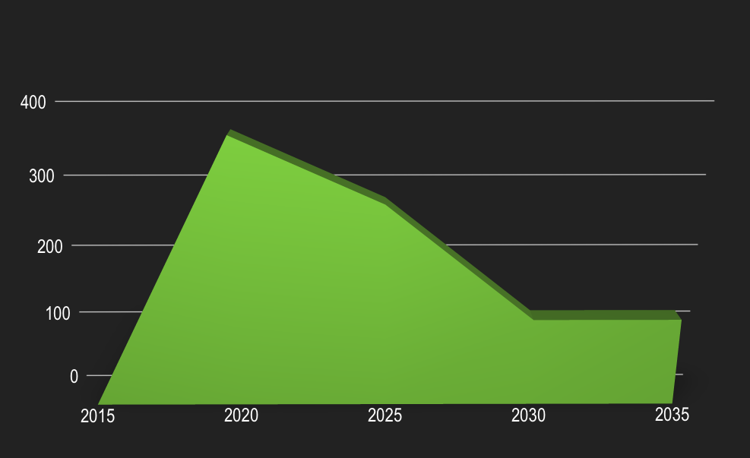
GROWTH PROJECTION TO 2035
Working Age Population (18-64 yrs.); Impact of Baby Boomers and New Workforce
Our skills gap issue will be coupled with a capacity issue to fill existing jobs in 15-20 years
Source: NC Office of Budget & Management

Slide 14
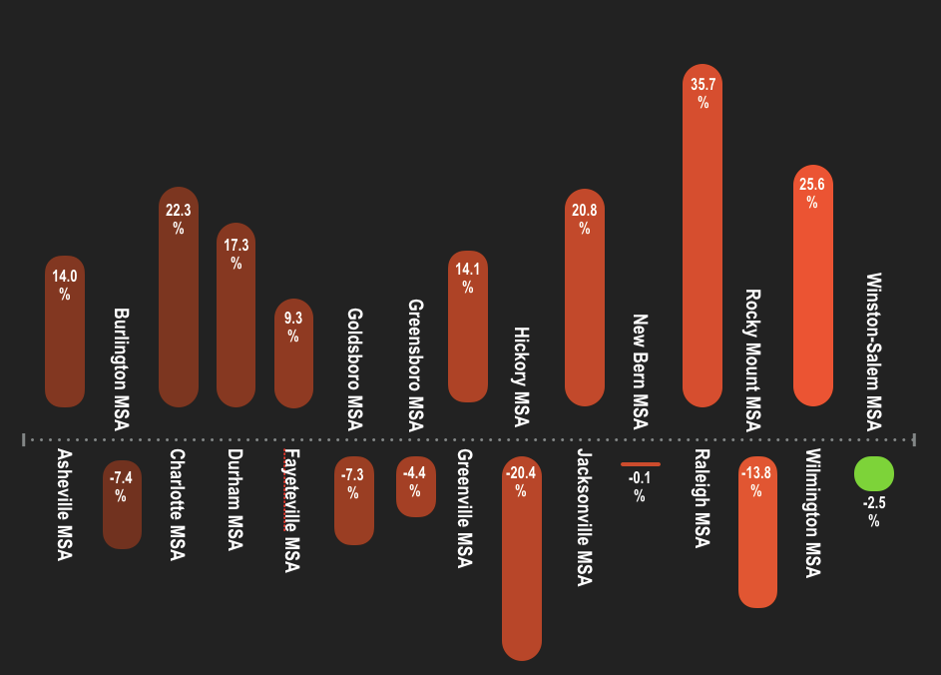
PERCENTAGE EMPLOYMENT CHANGE
DAVIE COUNTY 2000-1015
2000-2016
Source: NC Labor and Economic Analysis Division, NC Department of Commerce, 2016

Slide 15
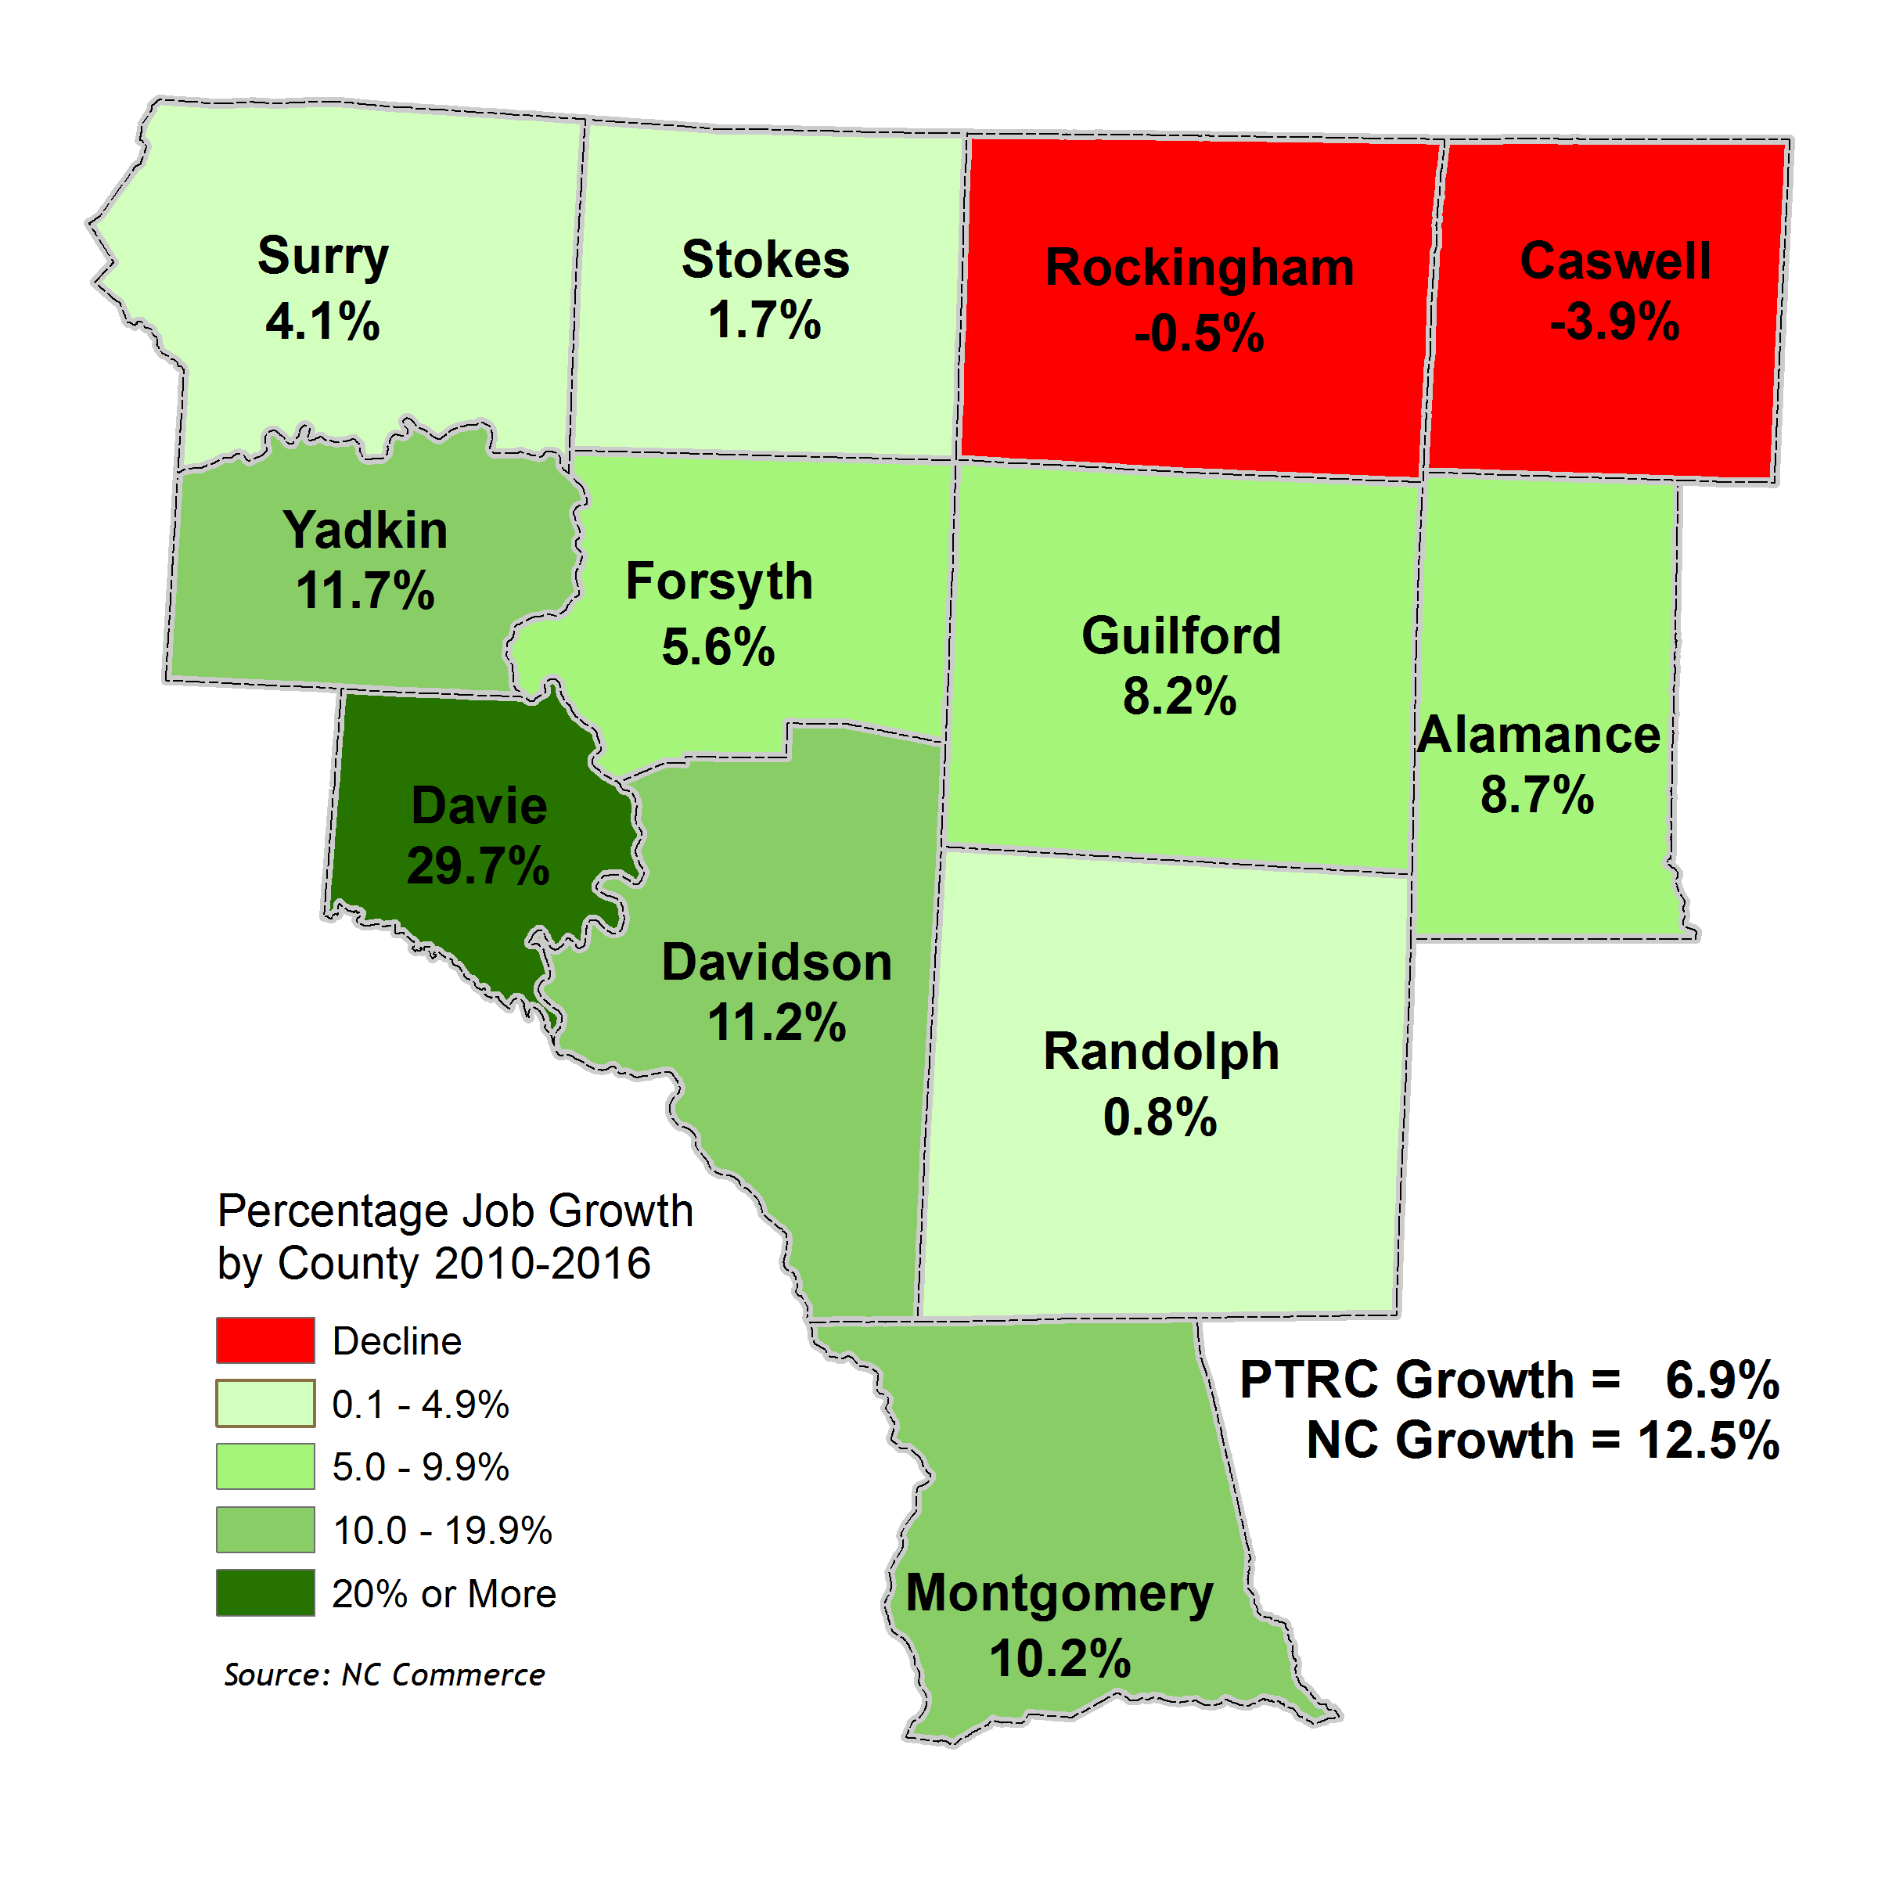
JOB GROWTH BY COUNTY
REGIONAL
JOB GROWTH
BY COUNTY
2010 – 2016

Slide 16
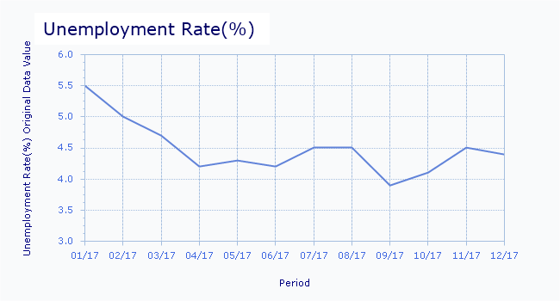
JOBS, LABOR FORCE, EMPLOYMENT
Source: Local Area Unemployment Statistics; Bureau of Labor Statistics (NC)

Slide 17
HOUSING UNITS, TYPE (%) & VALUE
Housing Types
76.1% of all units are single-family units
18.9% are mobile homes
Only 5% are multi-family units
 | Housing Units | Vacancy Rate | Rental Rate | % Single Family | % Multi-family | % Mobile Homes
Davie | 18,241 | 14.2% | 22.7% | 76.6% | 5.0% | 18.3%
Forsyth | 160,820 | 9.9% | 38.3% | 70.3% | 25.5% | 4.2%
Stokes | 21,868 | 12.2% | 22.8% | 67.8% | 4.4% | 27.8%
Surry | 33,625 | 14.2% | 27.7% | 67.6% | 7.5% | 24.8%
Yadkin | 17,242 | 11.3% | 23.7% | 68.0% | 3.6% | 28.4%
State | 4,453,767 | 14.3% | 35.2% | 68.7% | 16.9% | 14.3%
Source: US Census Bureau American Community Survey 5-Year Estimates (2012-2016) Housing Comparison (2016),

Slide 18
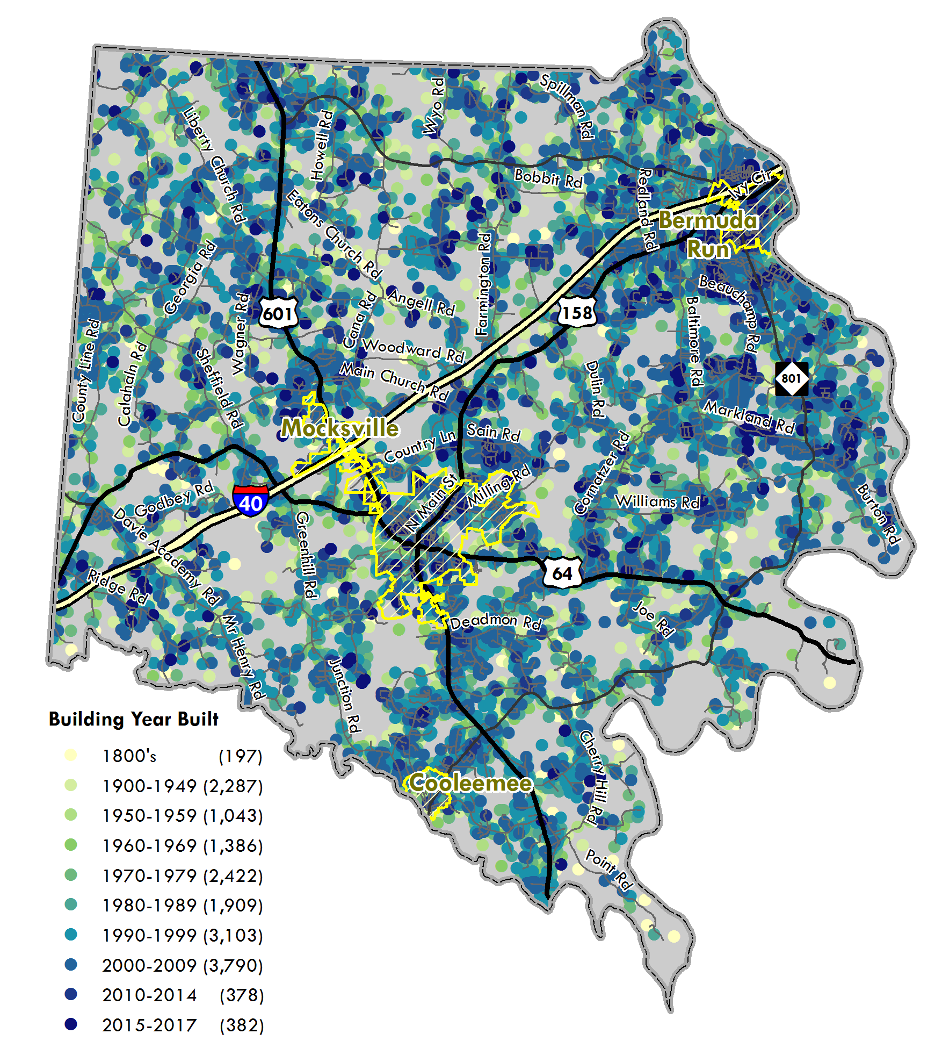
HOUSING DENSITY AND YEAR BUILT
YEAR BUILT
1800-2017
SOURCE: US CENSUS BUREAU, PTRC

Slide 19
LAND USE PLANNING
As a response to customer requests for more electronic services, our Development & Facility Services Department is moving forward to expand our convenient online services including:
Contractors custom log in to track their projects
Requesting inspections
Payment online
Applying for permits online
Uploading applications & documents
Electronic signatures
New programming to allow for text/email inspection status notifications
Next day inspections
1 day review time for applications

Slide 20
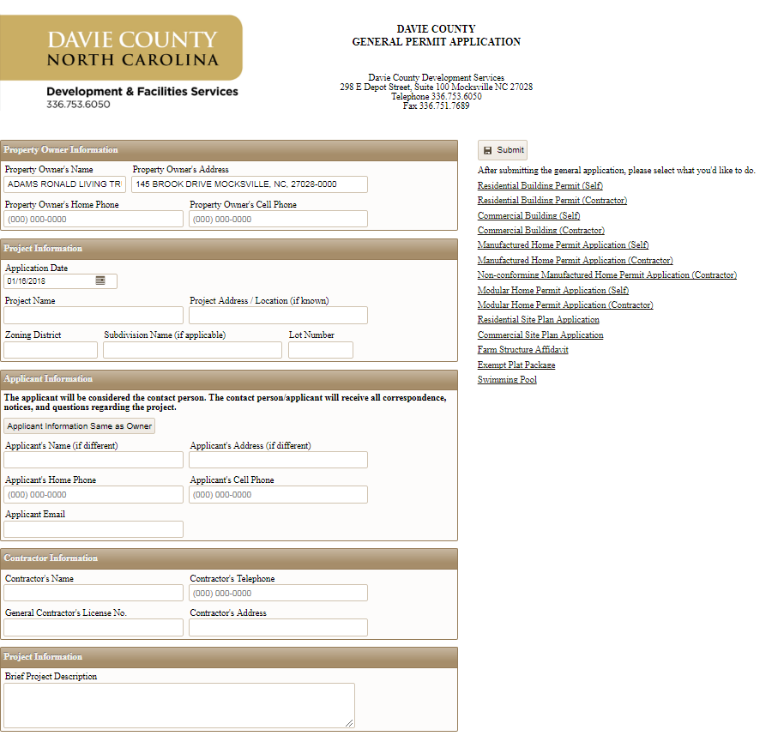
LAND USE PLANNING
Preview of Online Application Portal
This will allow for the customer to apply & track their project eliminating the need for paper applications & repeated office visits.

Slide 21
UTILITY INFRASTRUCTURE
UTILITY INFRASTRUCTURE
Creating a strategic water and waste water master plan that will align with the Davie County updated land use plan. Renewal and replacement program investing $500,000 annually into new and existing water and waste water infrastructure.
North Eastern Davie Sewer Collection System expansion is slated to begin construction in October 2018, expanding capacity for existing and future residential and commercial growth.

Slide 22
North East Davie Funding Sources
UTILITY INFRASTRUCTURE
UTILITY INFRASTRUCTURE
Primary funding through Clean Water State Revolving Funds Loan
“Letter of Intent to Fund” has been obtained
Interest rates are ½ of the market rate
20-year term
State and Federal funds
County is seeking additional funding through Economic Development Assistance (EDA) for $2M.
Federal funding grant from jobs creation
Currently in Phase 2 of the two-step application process
Cost of the total project is currently $17.6M

Slide 23
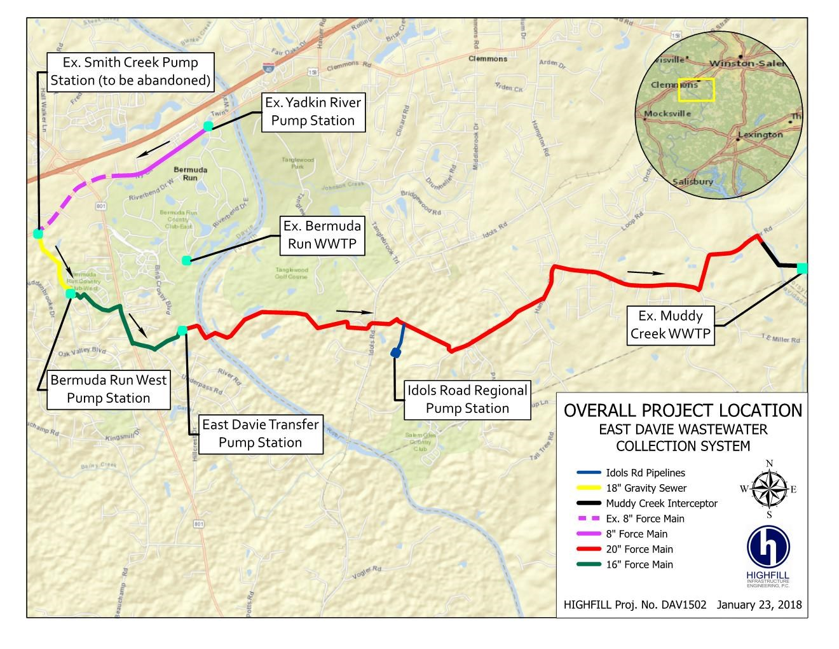
UTILITY INFRASTRUCTURE
UTILITY INFRASTRUCTURE

Slide 24
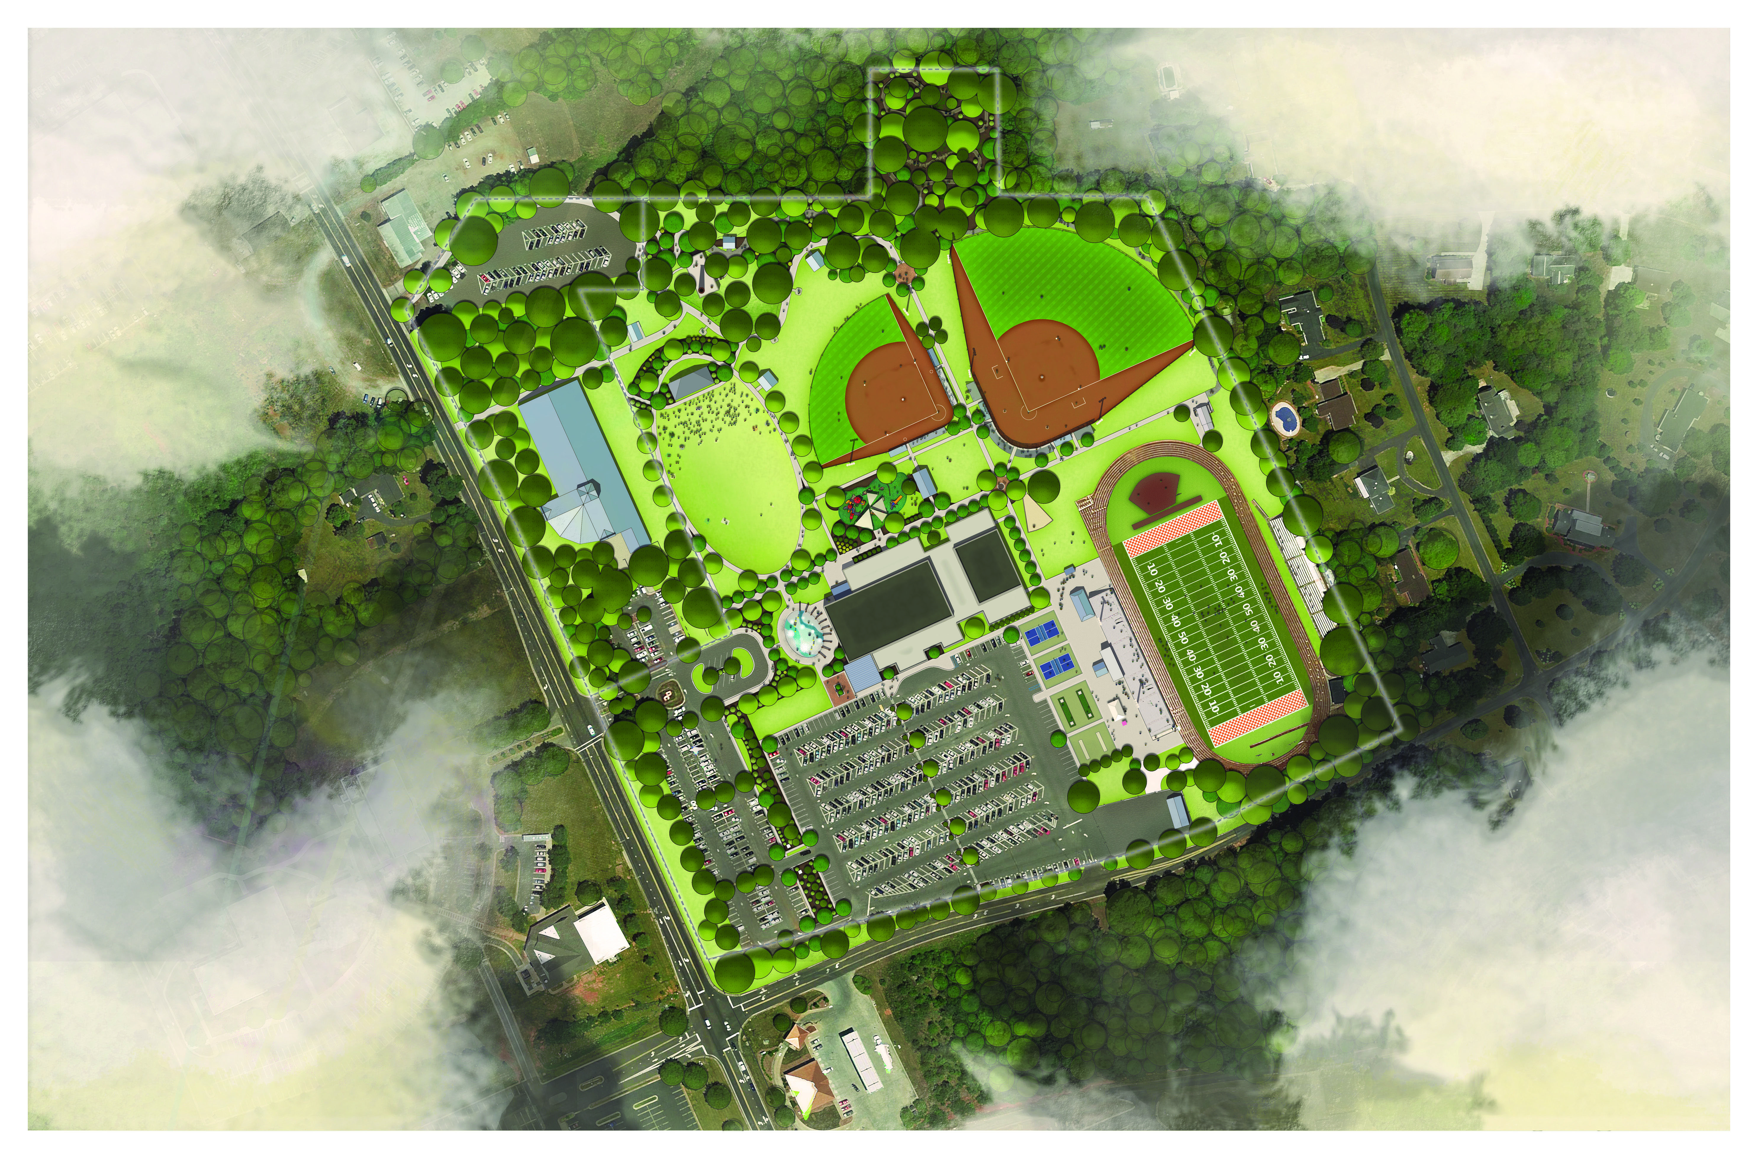
UTILITY INFRASTRUCTURE
PARK MASTER PLAN
Phase I - Projected Completion: Summer 2019
Exterior Program
Splash Pad
300’ Softball/baseball field
Inclusive playground
Amphitheater Building
Civic Green
Medium Shelter (2)
Dog Park (1 acre)
Trails
Parking Lot Upgrades
Sidewalks
Landscaping
Lighting
Entry & Wayfinding Signage
210’ Baseball/ Tee-ball field
Family Exercise Area
Team Building Course
Pickleball Courts
Upgrade Football Field to Turf
Large Shelter (1)
Small Shelter (2)
Nature Center
Small restroom Building
Maintenance Building
Interior Program
Roof Renovation
Renovate Existing Entry Elements
New Restrooms
Building Systems
Environmental Assessment & Abatement
Demo restrooms & showers
New Program Spaces
Interior Finishes Updates
Six (6) of the top ten (10) programs elements that our residents and advisory board have identified as top priorities are included in Phase 1.
27% of the park bond funding is dedicated to maintaining and upgrading the existing gymnasium building
Phase I Elements
PARTF Phase I
Future Phase Elements

Slide 25
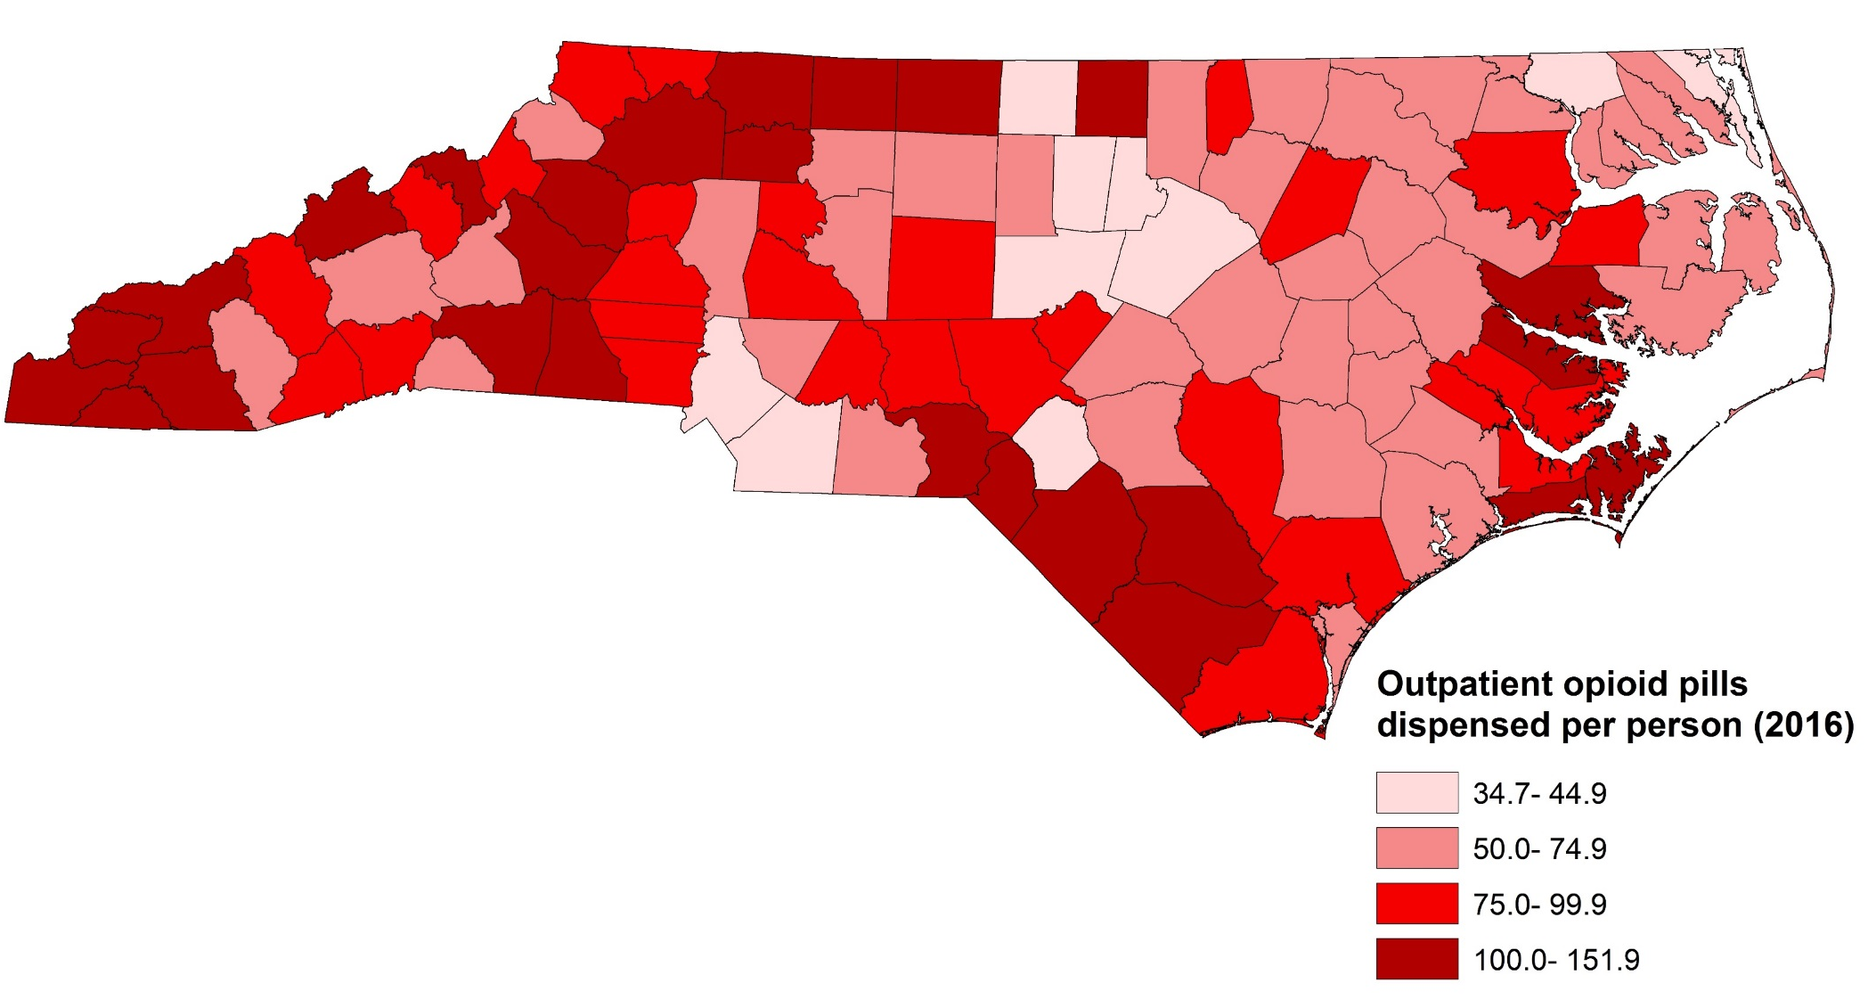
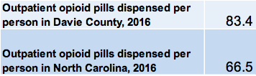

QUALITY OF LIFE - SUBSTANCE ABUSE
UTILITY INFRASTRUCTURE
Rate of Outpatient Opioid Pills Dispensed by County
per North Carolina Resident, 2016
Source: Opioid Dispensing – NC Division of Mental Health, Controlled Substance Reporting System, 2016/ Population- National Center for Health Statistics, 2016
Analysis: Injury Epidemiology and Surveillance Unit

Slide 26
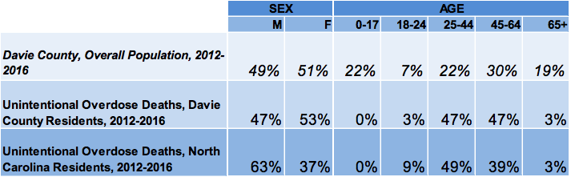
QUALITY OF LIFE - SUBSTANCE ABUSE
UTILITY INFRASTRUCTURE
County Demographics of Unintentional Medication & Drug Overdose Deaths
By Sex/Age: 2012-2016
Source: Deaths-N.C. State Center for Health Statistics, Vital Statistics, 2012-2016, Unintentional medication and drug overdose: X40-X44/Population-National Center for Health Statistics, 2012-2016
Analysis by Injury Epidemiology and Surveillance Unit

Slide 27
UTILITY INFRASTRUCTURE
QUALITY OF LIFE - CRIME RATES
2016 Crime Statistics
County | Index Rate | Violent Rate | Property Rate | Murder Rate | Rape Rate | Robbery Rate | Assault Rate | Burglary Rate | Larceny Rate | MVT Rate | Arson Rate
Davie | 1,825.7 | 163.7 | 1,662.0 | 0.0 | 14.1 | 8.5 | 141.1 | 536.1 | 1,058.2 | 67.7 | 2.8
Forsyth | 5,090.8 | 651.5 | 4,439.2 | 7.4 | 34.4 | 141.8 | 467.9 | 1,091.0 | 3,109.9 | 238.3 | 29.5
Stokes | 2,271.8 | 153.8 | 2,117.9 | 4.2 | 8.4 | 2.1 | 139.1 | 503.7 | 1,521.5 | 92.7 | 4.2
Surry | 3,001.0 | 167.9 | 2,833.1 | 2.7 | 20.5 | 31.4 | 113.3 | 846.1 | 1,853.3 | 133.7 | 24.6
Yadkin | 2,173.1 | 231.2 | 1,941.8 | 2.8 | 19.5 | 25.1 | 183.9 | 660.3 | 1,159.0 | 122.6 | 5.6
McDowell | 3,121.3 | 161.9 | 2,959.4 | 6.7 | 18.0 | 33.7 | 103.4 | 958.0 | 1,763.1 | 238.4 | 51.7
State | 3,154.5 | 374.9 | 2,779.7 | 6.9 | 21.1 | 95.9 | 251.0 | 721.6 | 1,904.7 | 153.3 | 14.9
Source: NC State Bureau of Investigation

Slide 28

COMMUNITY ENGAGEMENT
ENGAGING PARTNERS & PUBLIC

Slide 29
Questions Asked
What qualities does Davie County possess that would make a family or business want to move here?
What concerns you about Davie County?
What activities should Davie County focus on in this Strategic Plan?

Slide 30
Question #1
What qualities does Davie County possess that would make a family or business want to move here?
Reputation/
Quality of schools
Vibrant community with
a welcoming feeling
Access to quality healthcare & medical center
Location & convenience to interstate, highways & railway
Strong values, sense
of community connectedness
Business that is thriving & plans for future infrastructure for continued economic development/business expansion
Low cost of living
Community activities, arts & culture
Low crime rate/ safe neighborhoods
Recreation & Parks

Slide 31
Question #2
What concerns you about Davie County?
Lack of housing for families & young professionals
Limited entertainment activities for children, youth and adults
Limited professional opportunities (jobs above the median income level)
Lack of behavioral health therapists/service providers for children, youth & adults
Decrease of young adults (ages 25-44) & young families
Drug issues are on the rise
Hidden homeless population
Lack of trust/openness among various groups
Lack of skilled workforce & professional jobs
There are rich & poor communities with little middle class

Slide 32
Question #3
What activities should Davie County focus on in this strategic plan?
Recruit businesses/industries that provide jobs above the median income
Proactive planning for future infrastructure needs (water, sewer, natural gas)
Recruit and retain teachers to remain competitive
Focus on reducing suicides & drug related deaths
Build effective relationships between county, towns, nonprofits, churches, businesses
Increase entertainment for younger populations
New/better workforce development programs (for individuals to obtain critical skills & “lifelong learning”)
Create family housing or rental units (to attract 25-44 population)
Connect citizens to needed resources available to assist them
Actively recruit young adults through effective marketing of jobs/tourism
5.82

Slide 33

WHAT IS NEEDED TO SUCCEED?
Target our investments to specific needs with measurable outcomes
Working partnerships among Towns, County, EDC, Education, Businesses, Faith Community, and Civic Groups to promote alignment
Provide more uniformity among local government regulations, ordinances and codes
Harness needed technologies and use data to make informed decisions
Create or update plans and policies throughout the County to ensure adequate infrastructure is consistent with managed, intentional growth (Comprehensive Land Use Plan, Utilities Master Plan, growth strategies, & capital improvements on public buildings)
Align our goals with our Economic Development Strategies (incentives, spec buildings, targeted recruitment, business expansion, etc.)
Provide fair and equitable tax incentives to new and existing expansion
Assess our aging housing stock in Davie County

Slide 34
WHAT IS NEEDED TO SUCCEED?
Address the decline in younger age demographics (specifically ages 25-44)
Retain current talent and attract/prepare “next gen” leadership through development & succession planning (apprenticeships, mentoring, college promise)
Quality of life & place is important
Maintain a reasonable cost of living
Promote green and sustainable practices, farming and food strategies
Improve access to quality physical and behavioral health services for residents (Medical/Health Care, Substance Abuse/Opioid Issues)
Maintain a safe community (crime rates, etc.)
Market new & existing amenities/activities (entertainment/recreation, greenway/trailway connectivity, parks, shopping, arts, etc.)
Income disparity & self sufficiency standards (hourly living wages & annual income needed without public or private assistance)
Identify our competitive advantage and improve community awareness through increased public relations, marketing and branding to tell our story

Slide 35
WHAT IS NEEDED TO SUCCEED?
Develop strategies to align Workforce Development needs (recruitment training/development, & retention concerns)
Align educational efforts that support life-long learning and educational initiatives that develop talent from pre-kindergarten to retirement (and beyond)
Maintain quality education & retain teachers

Slide 36







STRATEGIC PLANNING FOCUS AREAS
Safe & Healthy Community | Growth & Infrastructure | Business Operations | Quality of Life & Place | Education

Slide 37

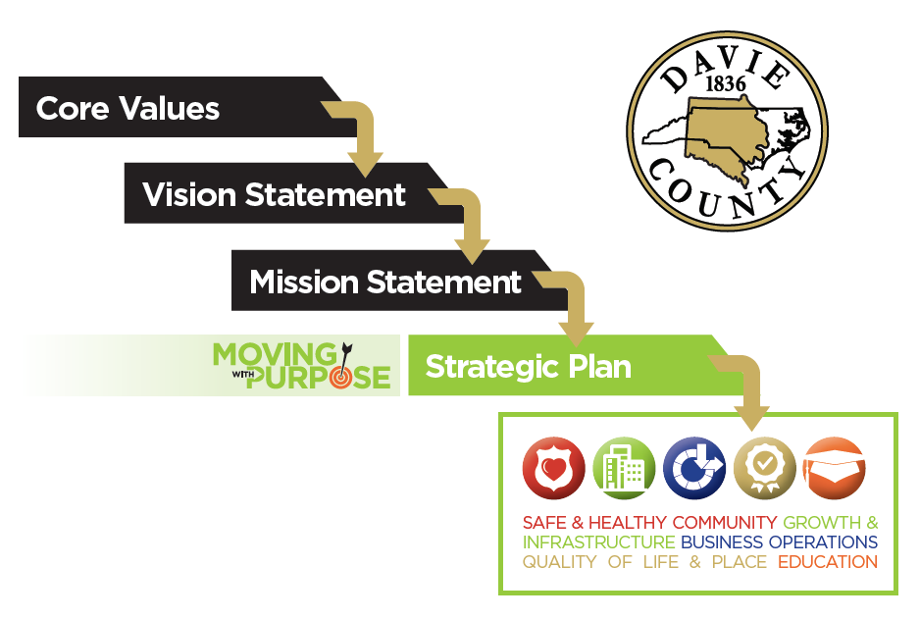
THE CASCADE EFFECT

Slide 38

BRINGING IT ALL TOGETHER
FINALIZING TOGETHER
BOC INPUT/
DIRECTION
COMMUNITY PARTNERS INPUT/DIRECTION
Strategies

Slide 39
COMMUNITY BRANDING
Bringing it all together to tell our story as a desirable place to live and work
PARTNERS
COUNTY
TOWNS
EMPLOYEES
EDC
CITIZENS
# WeAreDavie

Slide 40


FEARS?
Lack of Implementation & Follow Through=Inaction
Our future depends on our present decisions…

Slide 41
#WeAreDavie
“Long range planning does not deal
with future decisions, but with the
future of present decisions.”
-Peter Drucker

